Slide 1
ISDS 7070 - Group Project
Grace O’Brien, Mason Young, Justin Rogstad

Slide 2

Overview of the data
The Data Set: Video Game Sales with Ratings
This data represents a list of video games that sold greater than 100,000 copies from the years 1980-2016.
It contains 16 total attributes such as:
Name
Genre
Platform
Year
Publisher
Rating
Regional and global sales
Etc.
Notes:
Justin – Our Team was tasked with creating a model, based on a selected data set, to predict a response variable.

Slide 3
Frame the Problem
The problem we want to solve is how to predict video game global sales
Based on our data, we can create two models that may do this
Initial Assumptions:
Global Sales are the sum of all individual country sales
This will be our dependant variable
Game developers are not recognized as important to the average consumer and are often connected to the publisher of the game
Video game sales prior to 1994 do not have relevance to modern systems and games
Notes:
Justin -

Slide 4
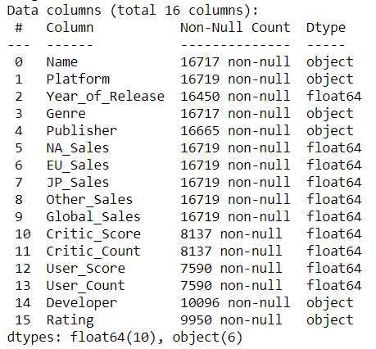
Explore the data
Dependent variable
Explanatory variables for the two models
Key Discoveries:
Total records: 16,719
Complete records: 6,819
All column names were logical and easily understood
The data passes the sanity test
Create two models and compare
One with more variables, but less data points that uses the complete records (the ‘wide model’)
One with more data points, but less variables that uses the columns that have close to the total records (the ‘narrow model’)
Notes:
Justin

Slide 5
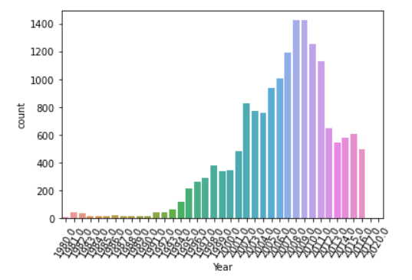
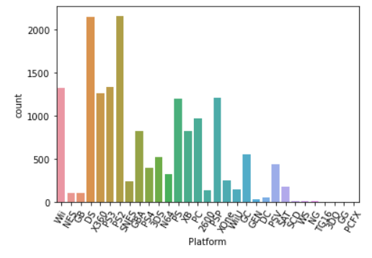
Explore the data
Value counts of Year column
Value counts of Platform column
Notes:
Justin

Slide 6
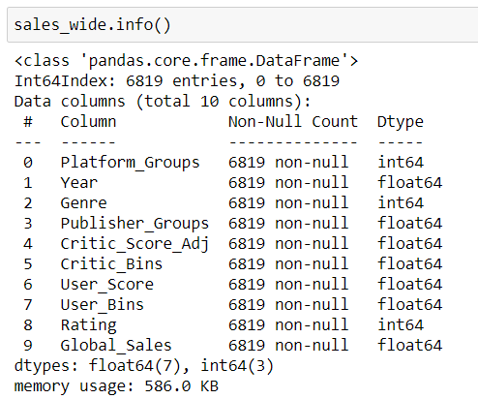
Wrangle the data: wide model
Post-wrangling
Dependent variable
Explanatory variables for the wide model
The wide model was built on the rows that had complete entries
Our main focus when wrangling the data was two-fold
Clear out rows missing data
Bin columns into categories where appropriate
Dropped columns: regional sales, developer
Binned columns: platform, publisher, user count, critic count
Eliminated rows that had missing values until we were left with complete entries
Notes:
Mason- clear missing + bin categories, dropped columns thought to be unessecessary, Idea was short and fat

Slide 7
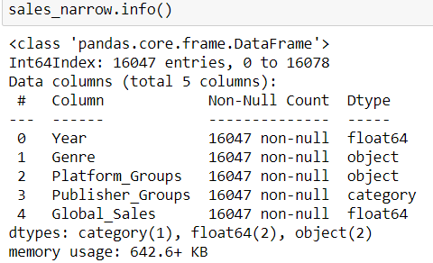
Wrangle the data: narrow model
Post-wrangling
Dependent variable
Explanatory variables for the narrow model
The narrow model was built on the columns that had 16,000+ data points
We again eliminated rows that were missing data and binned columns where appropriate
Dropped columns: regional sales, critic score and count, user score and count, developer, rating
Binned columns: platform, publisher
Any rows in the remaining columns that were missing values were dropped (only a few for this model)
Notes:
Mason – idea was narrow and tall, kept rows w/most of data. Limited NaN rows to deal with

Slide 8


Identify promising models
Using a random forest, we built our two models
The wide variation of the data proved more valuable than the increased number of rows
We were surprised with how low our R-squared score was for both
The wide model fit the data the best, but less than 25% of the data fit the model
Since the narrow model had such a lower score than the wide model, we decided to take a new approach to the wide model to see if we could create a model that fit more of the data
Wide
Narrow
Notes:
Mason –wide was obviously best option for prediction but still needed work. It fit model best

Slide 9

Tune the models
We first changed how we approached the binning of our models
Increased the bins of the publisher groups
Remove the bins for user count and critic count (both contained numerical data)
These changes helped our data fit the model much better
Our R-squared score increased to 0.40
Now that around 40% of the data fit the model, we wanted to adjust the hyper-parameters to get as close to 50% as we could
Utilized a parameter grid search to do this
The best R-squared score we achieved was 0.48
Updated Wide Model
Notes:
Grace -

Slide 10

Surprises throughout the process
Binning too many columns had a significant negative impact on the accuracy of the model
We tried a version of the model with global sales binned, but it was less accurate than the narrow model
Even though the narrow model had almost 2.5x entries as the wide model, the missing columns were more important to the model’s accuracy
Notes:
Grace – mention 83% logic error model

Slide 11
Conclusion
While having a large quantity of rows in a dataset is important, it can be equally or even more important to have a good number of columns in the dataset
In some cases, it is better to leave numerical data un-binned
Sales can be hard to predict, and having information on the product itself is not always enough
Models predicting sales may also need information on the market, advertising, consumers, etc. to be accurate
Notes:
Grace – questions or want further details on technical building of the model?

